Slide 1
Blog Space
A full-stack blogging platform built using Django (backend), React (frontend), and SQL (database). This application allows users to manage blogs securely and efficiently, with features like token-based authentication, encrypted password storage, blog categorization, and commenting.
Developed by – Vijay Joglekar

Slide 2
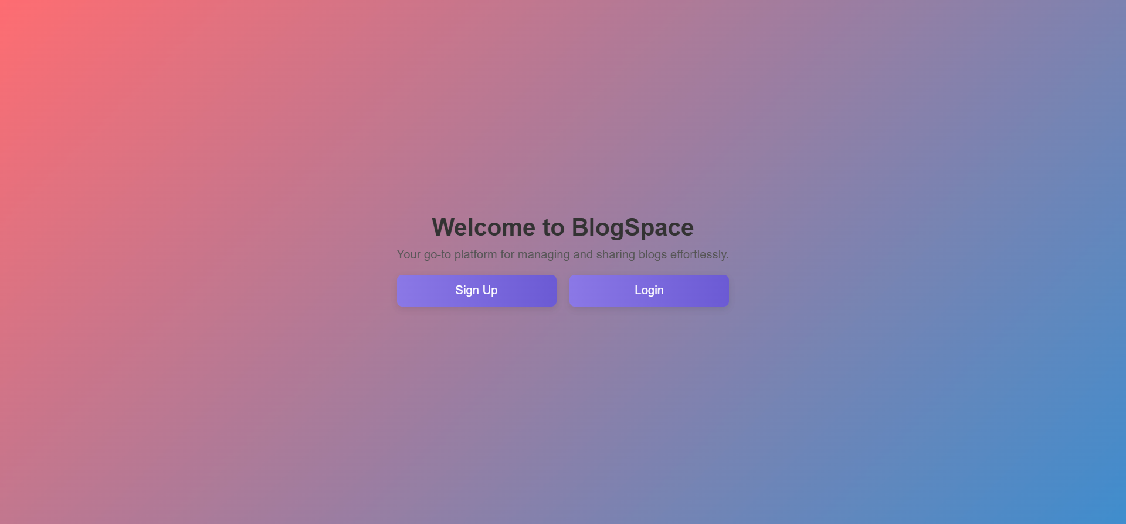

Slide 3
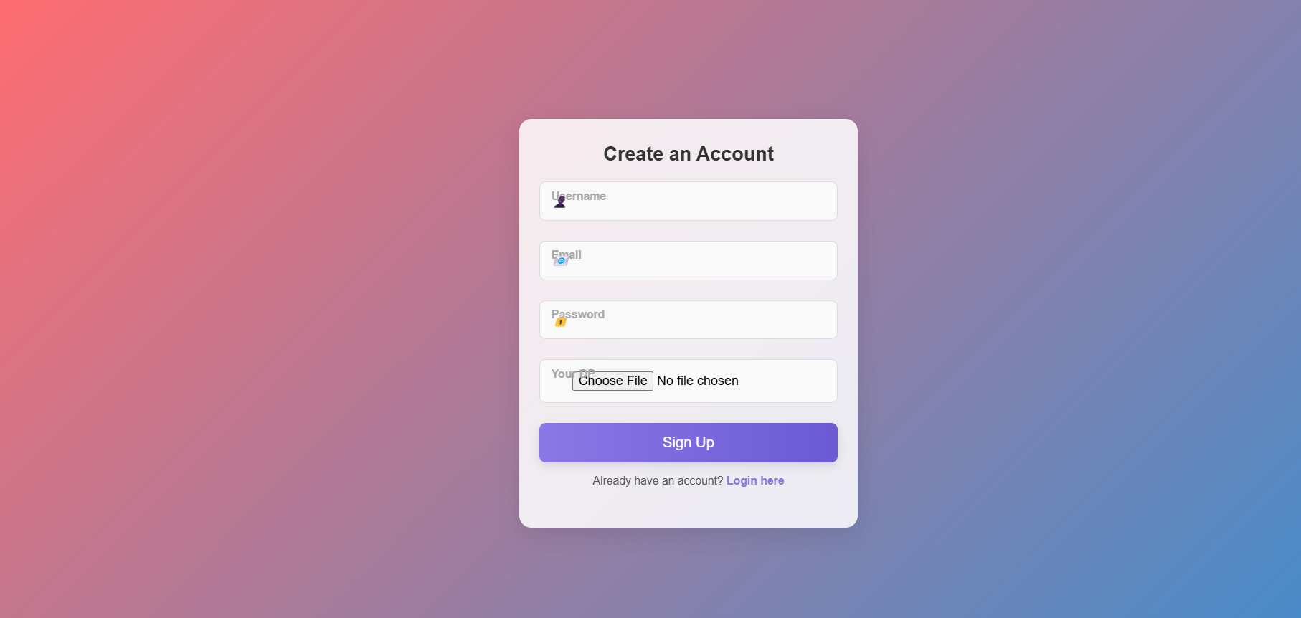

Slide 4
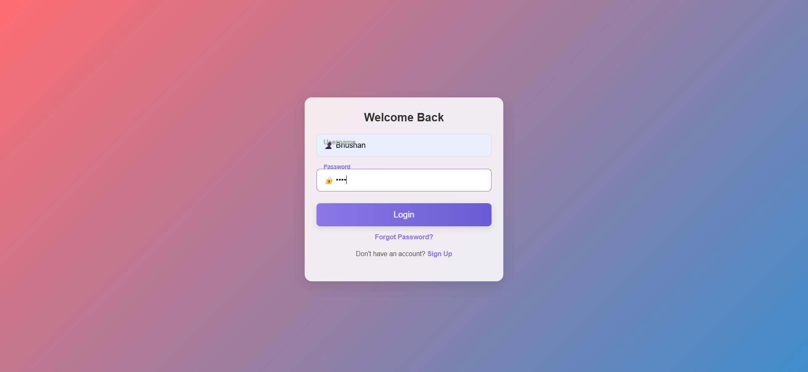

Slide 5
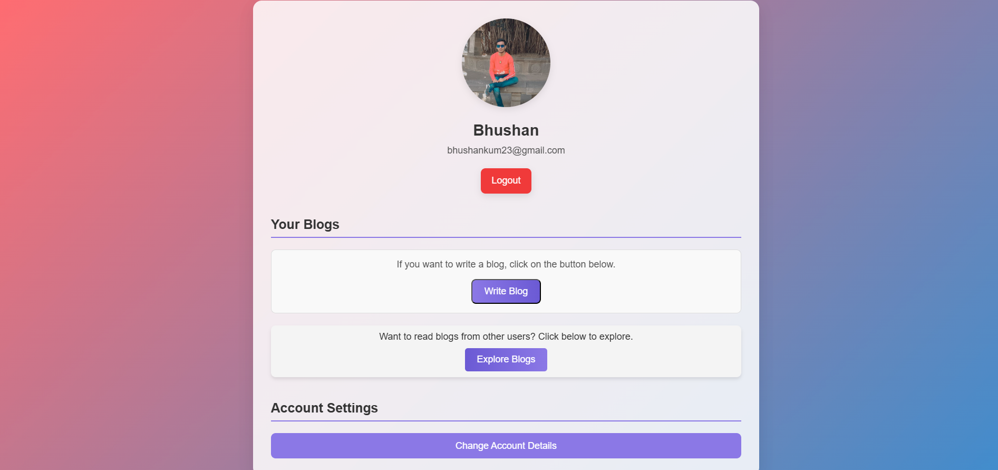

Slide 6
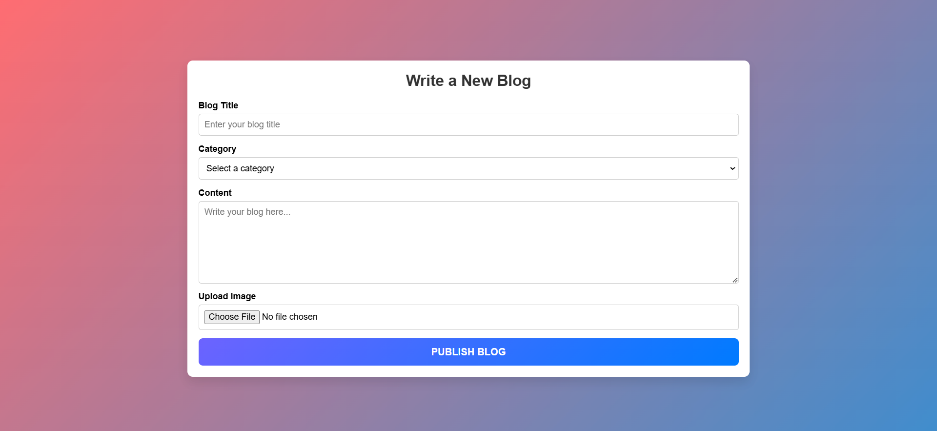

Slide 7
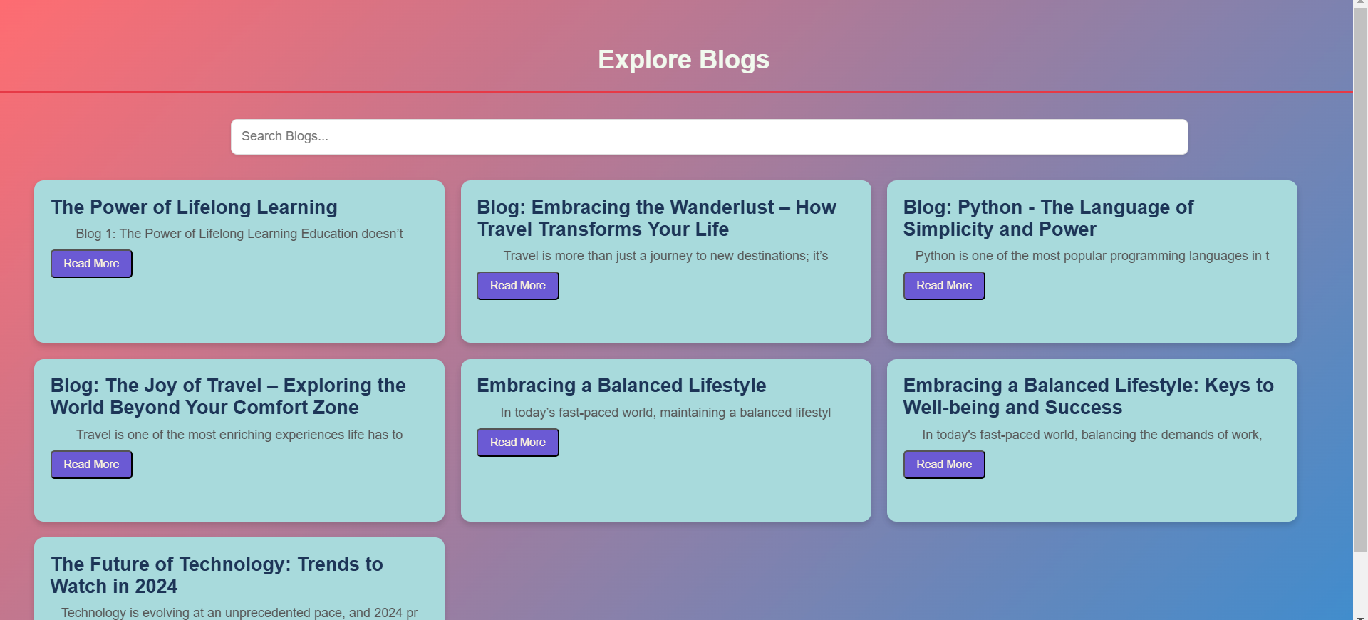

Slide 8
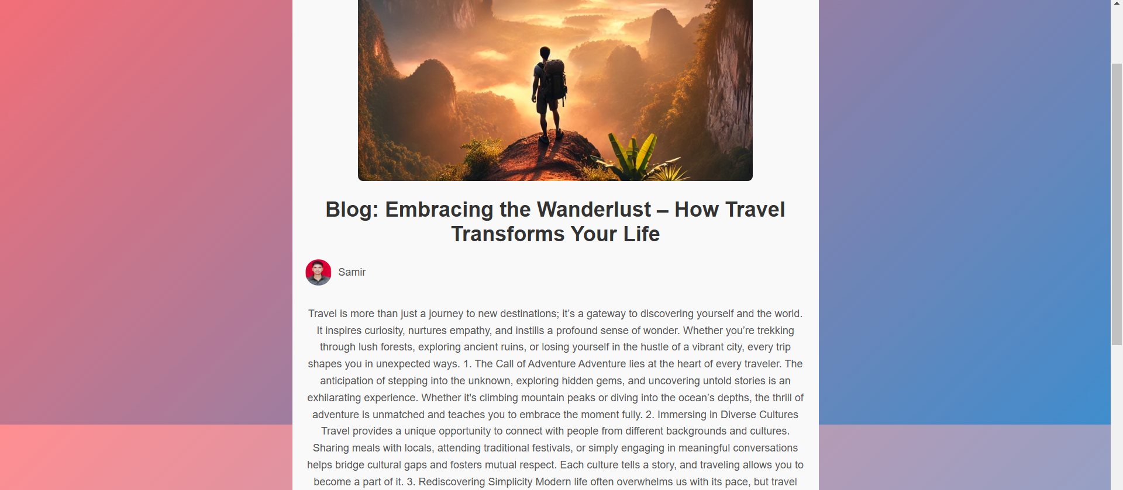

Slide 9
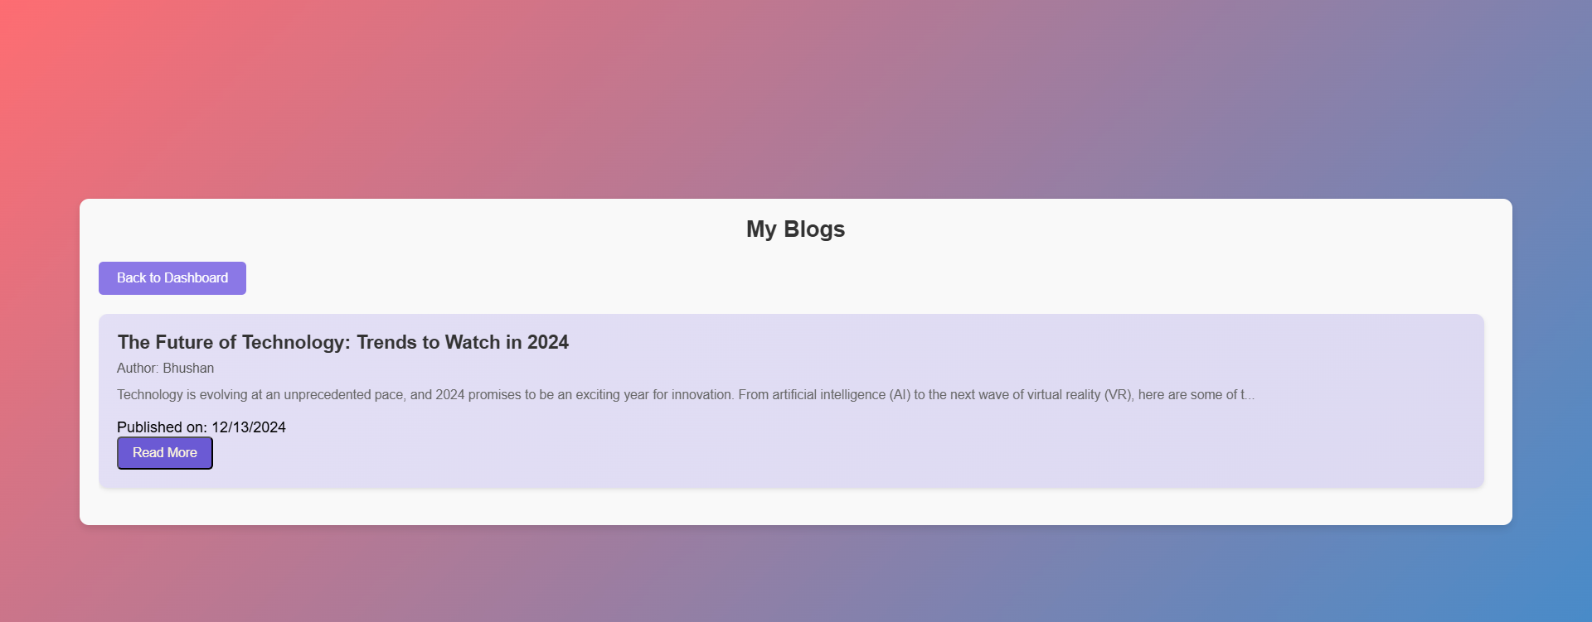

Slide 10
Thank you
By- Vijay Joglekar

